Slide 1
CAPSTONE PROJECT
FANDANGO MOVIE RATING DISCREPENCY ANALYSIS
Presented By:
NAME : E.VINOTH
COLLEGE NAME : SHIVANI ENGINEERINGCOLLEGE DEPARTMENT : BE.MECHANICAL ENGINEERING

Slide 2
OUTLINE
Problem Statement
Proposed System/Solution
System Development Approach
Algorithm & Deployment
Result
Conclusion
Future Scope
References

Slide 3
PROBLEM STATEMENT
To Analysis the fandango movie Rating in all sites vs own sites
To know the appropriate movie rating based on graphical data

Slide 4
PROPOSED SOLUTION
.
By using advanced machine learning system to visualization of actual rating of films
To easy to understand which type of movies people to like
Most likely movies and most avoided movies to understand easily

Slide 5
SYSTEM APPROACH
Hardware:
A laptop with sufficient processor
Adequate RAM to handle the size of Dataset
Software:
Operating system with machine learning library ( Windows, Linux, macOS)

Slide 6
ALGORITHM & DEPLOYMENT
Data Input:
Data Collection
Data Cleaning
Feature Engineering
Training Process:
Data Splitting
Feature Scaling
Model Training
Model Evaluation

Slide 7
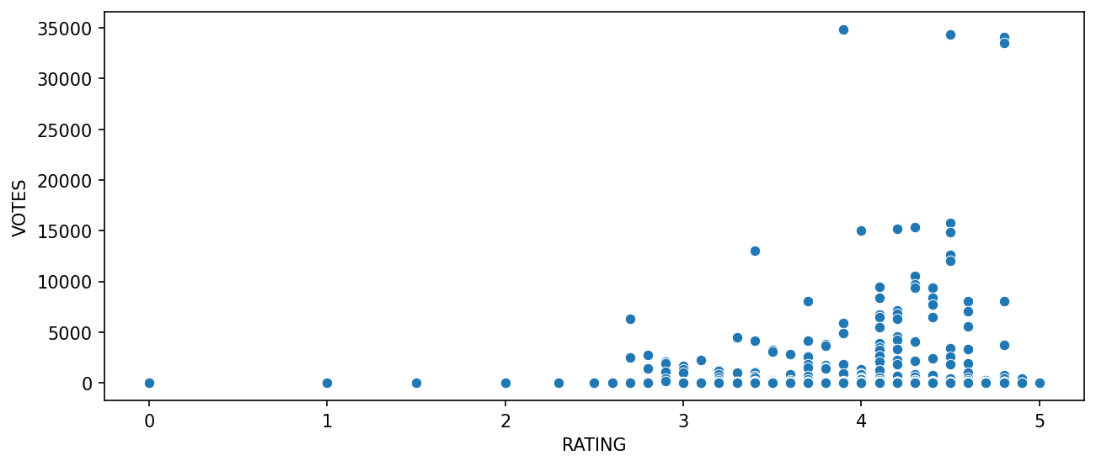
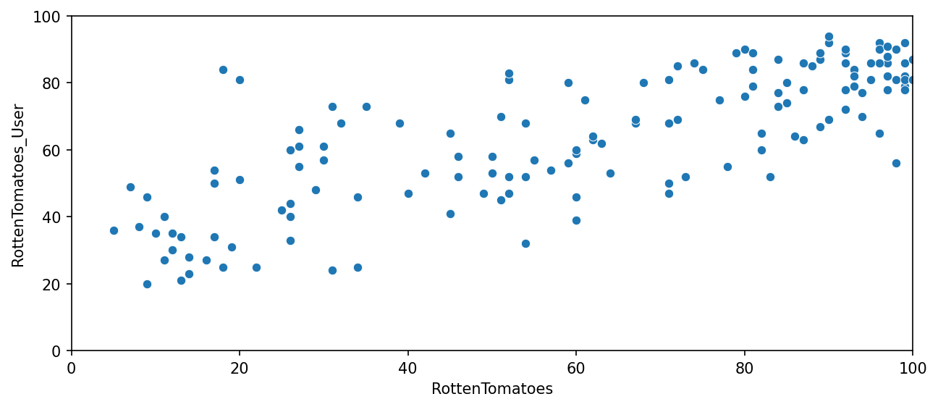
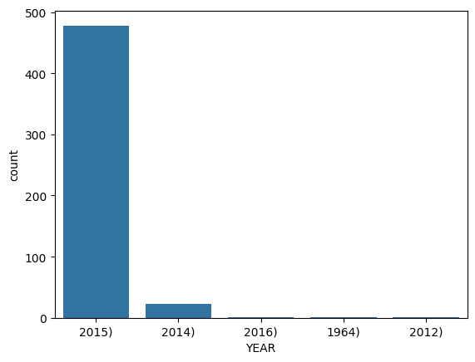
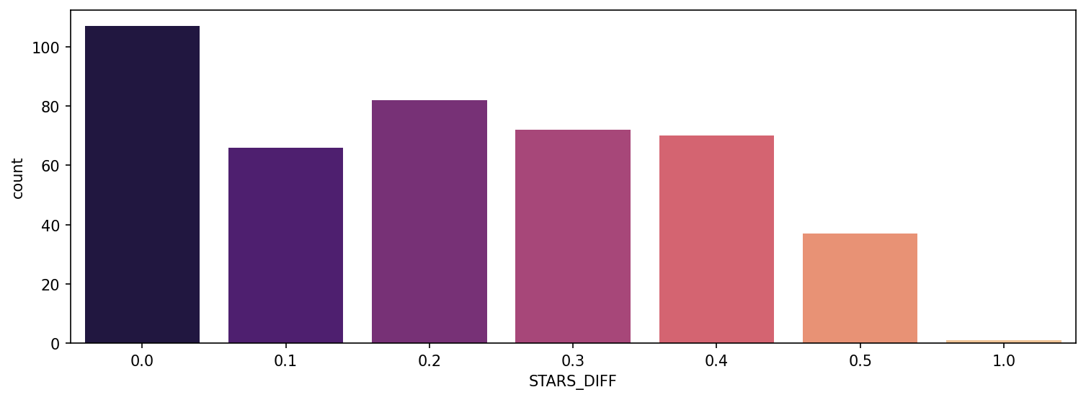
RESULT

Slide 8
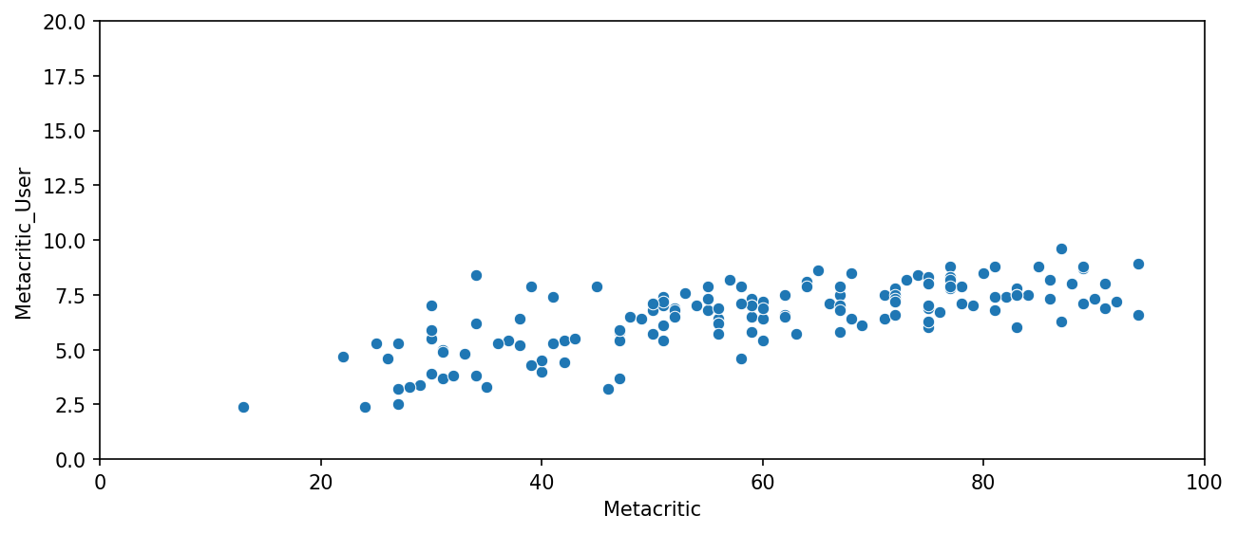
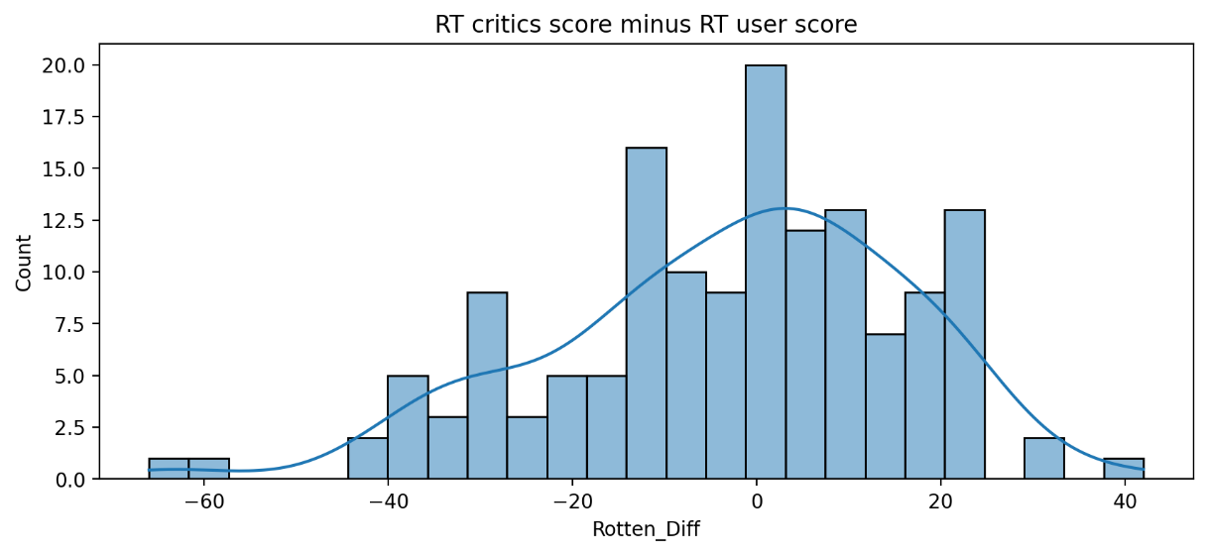
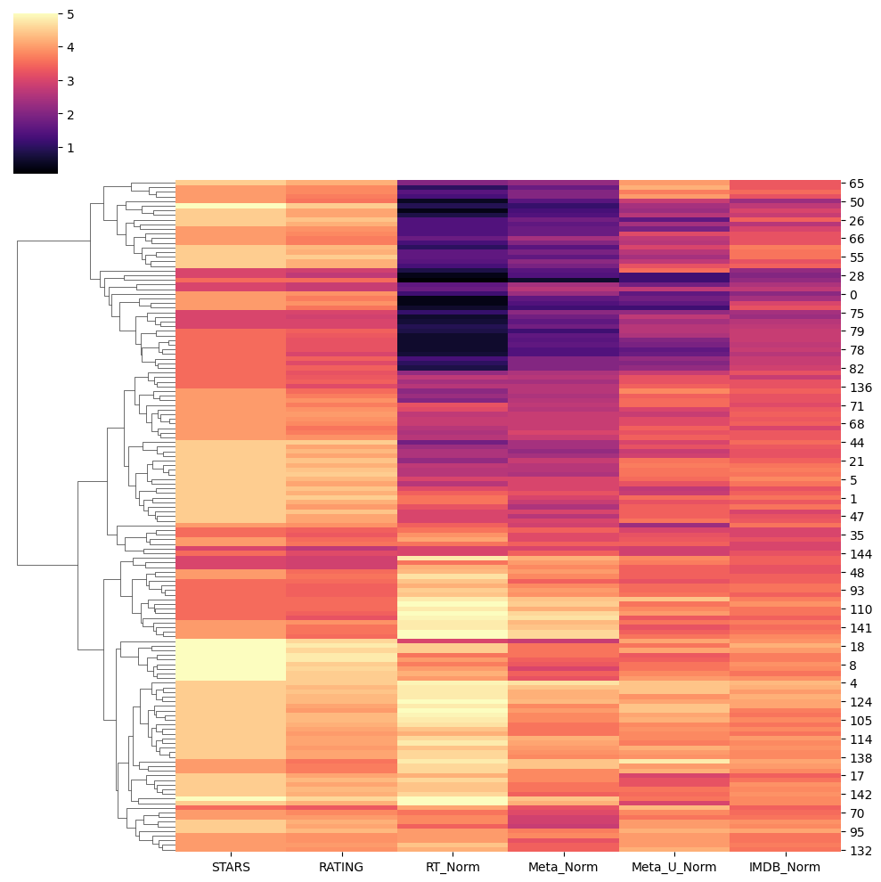
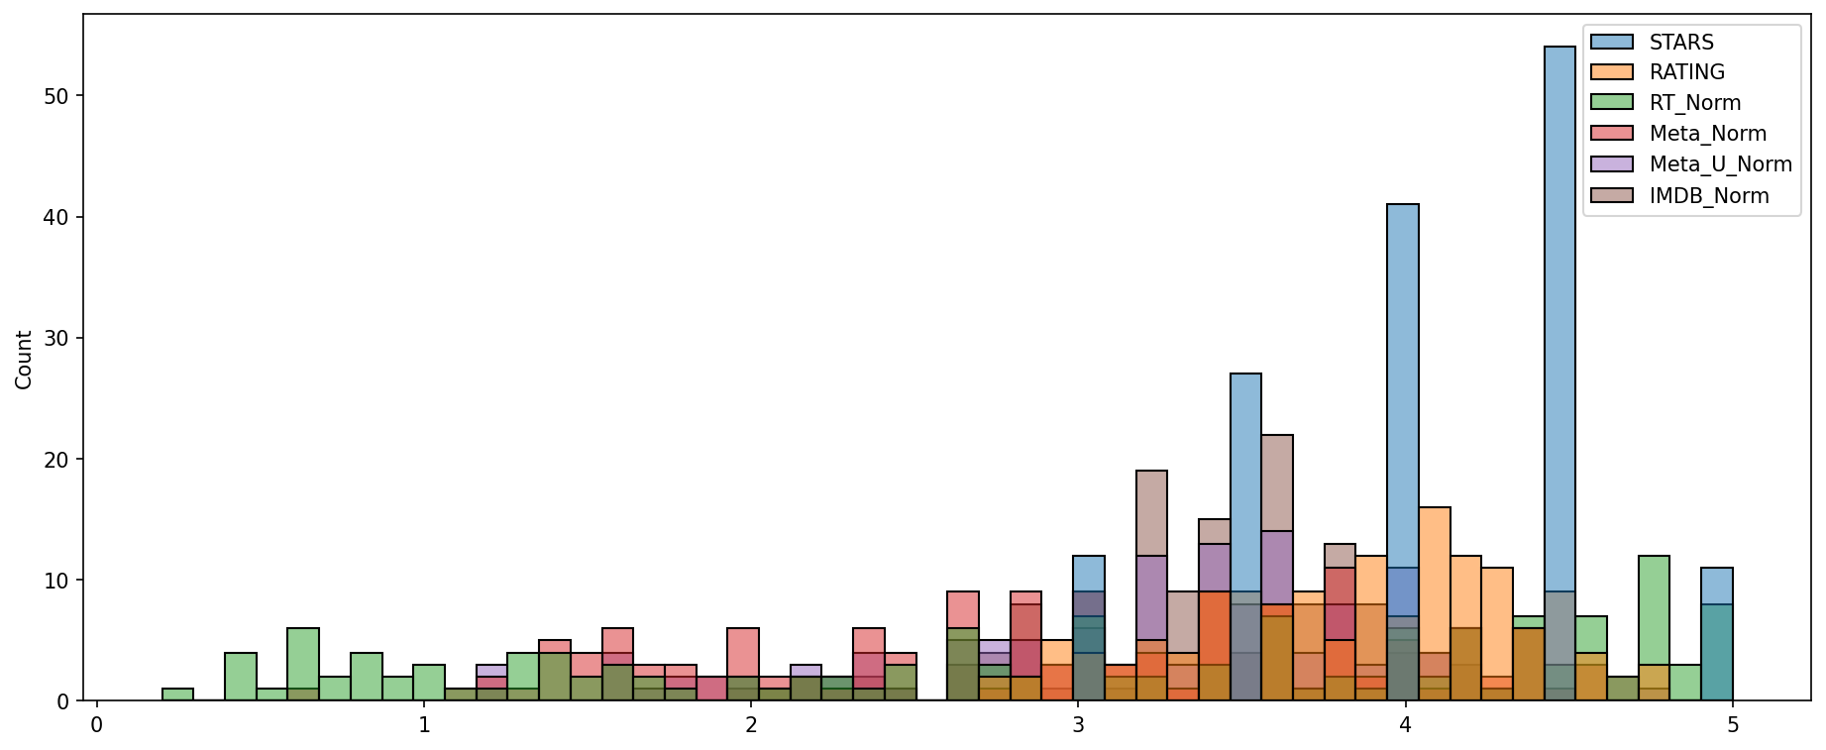
RESULT

Slide 9
CONCLUSION
Finally we analysis which movie get greater rating which one is least rating , which movie was most liked by peoples and rating diff from all sites vs our sites. which movie get higher IMDB rating also we analysis and also visualizing to easy understanding.

Slide 10
FUTURE SCOPE
Real time Prediction
Personalization and customization

Slide 11
REFERENCES
https://skills.yourlearning.ibm.com/?lang=en&ngo-id=0107&strategy=google
https://www.kaggle.com/datasets/rislam4/fandango-data-set?resource=download
https://colab.research.google.com/

Slide 12
THANK YOU

